Slide 1
Inclusion-exclusion principle

Slide 2
Inclusion-exclusion principle
The rule of sum describes the way of counting the "cardinality"
(the size of the set) of two disjoint sets (specifically: the union
of two disjoint sets).

Slide 3
Inclusion-exclusion principle
The rule of sum describes the way of counting the "cardinality"
(the size of the set) of two disjoint sets (specifically: the union
of two disjoint sets).
For disjoint sets $A$ and $B$ we have $\left|A∪B\right|=\left|A\right|+\left|B\right|$, where $\left|S\right|$
denotes cardinality (the size of the set – finite or infinite) of the set $S$.

Slide 4

Inclusion-exclusion principle
The rule of sum describes the way of counting the "cardinality"
(the size of the set) of two disjoint sets (specifically: the union
of two disjoint sets).
For disjoint sets $A$ and $B$ we have $\left|A∪B\right|=\left|A\right|+\left|B\right|$, where $\left|S\right|$
denotes cardinality (the size of the set – finite or infinite) of the set $S$.
More generally, for disjoint sets $A_{1}, A_{2},…,A_{n}$ we have:
$$\left|\bigcup_{i=1}^{n}{A_{i}}\right|=\sum_{i=1}^{n}{\left|A_{i}\right|}$$
Which reads as: the cardinality of the union of sets $A_{1}∪A_{2}∪…∪A_{n}$ is equal to the sum of the cardinalities of the sets $A_{1}+A_{2}+…+A_{n}$ – equivalently:
$$\left|A_{1}∪A_{2}∪…∪A_{n}\right|=\left|A_{1}\right|+\left|A_{2}\right|+…+\left|A_{n}\right|$$

Slide 5
Inclusion-exclusion principle
The rule of sum describes the way of counting the "cardinality"
(the size of the set) of two disjoint sets (specifically: the union
of two disjoint sets).
For disjoint sets $A$ and $B$ we have $\left|A∪B\right|=\left|A\right|+\left|B\right|$, where $\left|S\right|$
denotes cardinality (the size of the set – finite or infinite) of the set $S$.
More generally, for disjoint sets $A_{1}, A_{2},…,A_{n}$ we have:
$$\left|\bigcup_{i=1}^{n}{A_{i}}\right|=\sum_{i=1}^{n}{\left|A_{i}\right|}$$
Which reads as: the cardinality of the union of sets $A_{1}∪A_{2}∪…∪A_{n}$ is equal to the sum of the cardinalities of the sets $A_{1}+A_{2}+…+A_{n}$ – equivalently:
$$\left|A_{1}∪A_{2}∪…∪A_{n}\right|=\left|A_{1}\right|+\left|A_{2}\right|+…+\left|A_{n}\right|$$
This formula does not hold if at least one pair of sets $A_{i}, A_{j}$ is not disjoint.

Slide 6
Inclusion-exclusion principle
The inclusion-exclusion principle allows us to count the number of elements
of the union of sets that are not necessarily disjoint.

Slide 7

Inclusion-exclusion principle
The inclusion-exclusion principle allows us to count the number of elements
of the union of sets that are not necessarily disjoint.
The formula for two sets: $A$ and $B$:
$$\left|A∪B\right|=\left|A\right|+\left|B\right|−\left|A∩B\right|$$
Which reads as: the cardinality of the union of sets is equal to the sum of the individual sets (their card.) minus the intersection of the sets. Visually:

Slide 8
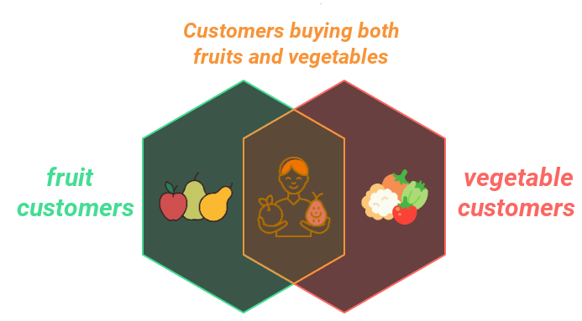
Inclusion-exclusion principle
The inclusion-exclusion principle allows us to count the number of elements
of the union of sets that are not necessarily disjoint.
The formula for two sets: $A$ and $B$:
$$\left|A∪B\right|=\left|A\right|+\left|B\right|−\left|A∩B\right|$$
Which reads as: the cardinality of the union of sets is equal to the sum of the individual sets (their card.) minus the intersection of the sets. Visually:

Slide 9
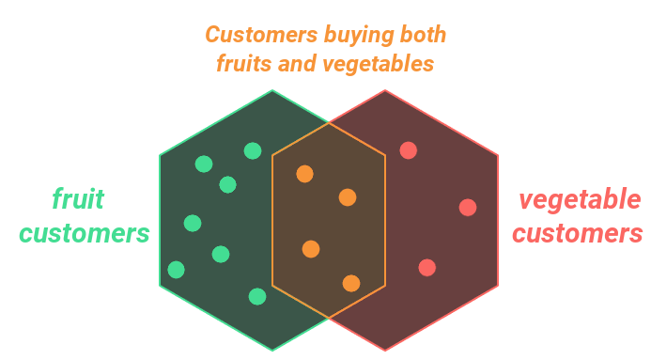

Inclusion-exclusion principle
Example situation:
We have $11$ customers for fruits, $7$ customers for vegetables,
and $4$ customers buying both fruits and vegetables.

Slide 10
Inclusion-exclusion principle
Example situation:
We have $11$ customers for fruits, $7$ customers for vegetables,
and $4$ customers buying both fruits and vegetables.
The total number of customers is: $11+7−4=14$

Slide 11
Inclusion-exclusion principle
Example situation:
If we only knew that there are $11$ customers for fruits and $7$ customers
for vegetables, we could only estimate the number of customers.

Slide 12
Inclusion-exclusion principle
Example situation:
If we only knew that there are $11$ customers for fruits and $7$ customers
for vegetables, we could only estimate the number of customers.
There number of customers is at least $11$, and at most $18$, i.e. $11≤K≤18$

Slide 13
Inclusion-exclusion principle
Example situation:
If we only knew that there are $11$ customers for fruits and $7$ customers
for vegetables, we could only estimate the number of customers.
There number of customers is at least $11$, and at most $18$, i.e. $11≤K≤18$
From the formula: $\left|A∪B\right|=\left|A\right|+\left|B\right|−\left|A∩B\right|$ immediately follows the
inequality: $\left|A∪B\right|≤\left|A\right|+\left|B\right|$

Slide 14
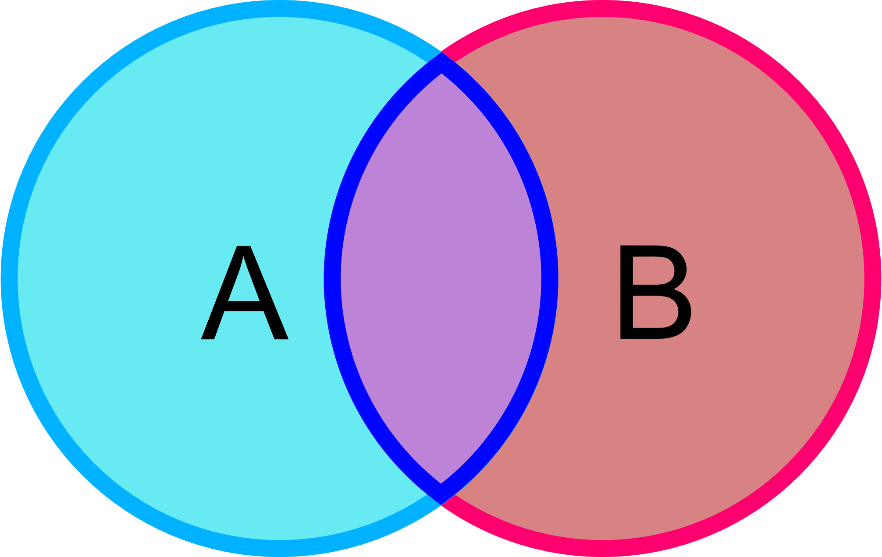
Inclusion-exclusion principle
For two sets, we have a Venn diagram:

Slide 15
Inclusion-exclusion principle
For two sets, we have a Venn diagram:
And the formula: $\left|A∪B\right|=\left|A\right|+\left|B\right|−\left|A∩B\right|$

Slide 16
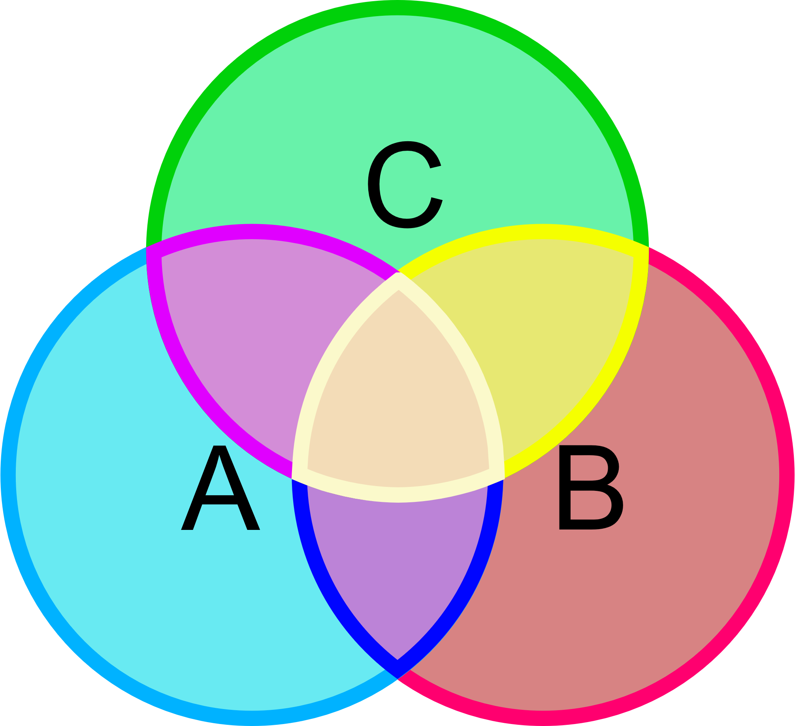
Inclusion-exclusion principle
For two sets, we have a Venn diagram:
And the formula: $\left|A∪B\right|=\left|A\right|+\left|B\right|−\left|A∩B\right|$
For three sets, we have a Venn diagram:

Slide 17
Inclusion-exclusion principle
For two sets, we have a Venn diagram:
And the formula: $\left|A∪B\right|=\left|A\right|+\left|B\right|−\left|A∩B\right|$
For three sets, we have a Venn diagram:
Formula: $\left|A∪B∪C\right|=\left|A\right|+\left|B\right|+\left|C\right|−\left|A∩B\right|−\left|A∩C\right|−\left|B∩C\right|+\left|A∩B∩C\right|$

Slide 18
Inclusion-exclusion principle
The cardinality formula of the union of two non-disjoint sets $A$ and $B$:
$$\left|A∪B\right|=\left|A\right|+\left|B\right|−\left|A∩B\right|$$

Slide 19
Inclusion-exclusion principle
The cardinality formula of the union of two non-disjoint sets $A$ and $B$:
$$\left|A∪B\right|=\left|A\right|+\left|B\right|−\left|A∩B\right|$$
The cardinality formula of the union of three non-disjoint sets $A$, $B$ and $C$:
$$\left|A∪B∪C\right|=\left|A\right|+\left|B\right|+\left|C\right|−\left|A∩B\right|−\left|A∩C\right|−\left|B∩C\right|+\left|A∩B∩C\right|$$

Slide 20

Inclusion-exclusion principle
The cardinality formula of the union of two non-disjoint sets $A$ and $B$:
$$\left|A∪B\right|=\left|A\right|+\left|B\right|−\left|A∩B\right|$$
The cardinality formula of the union of three non-disjoint sets $A$, $B$ and $C$:
$$\left|A∪B∪C\right|=\left|A\right|+\left|B\right|+\left|C\right|−\left|A∩B\right|−\left|A∩C\right|−\left|B∩C\right|+\left|A∩B∩C\right|$$
The cardinality formula of the union of four non-disjoint sets $A$, $B$, $C$ and $D$:
$$\left|A∪B∪C∪D\right|=\left|A\right|+\left|B\right|+\left|C\right|+\left|D\right|$$
$$−\left|A∩B\right|−\left|A∩C\right|−\left|A∩D\right|−\left|B∩C\right|−\left|B∩D\right|−\left|C∩D\right|$$
$$+\left|A∩B∩C\right|+\left|A∩B∩D\right|+\left|A∩C∩D\right|+\left|B∩C∩D\right|$$
$$−\left|A∩B∩C∩D\right|$$

Slide 21
Inclusion-exclusion principle
The cardinality formula of the union of two non-disjoint sets $A$ and $B$:
$$\left|A∪B\right|=\left|A\right|+\left|B\right|−\left|A∩B\right|$$
The cardinality formula of the union of three non-disjoint sets $A$, $B$ and $C$:
$$\left|A∪B∪C\right|=\left|A\right|+\left|B\right|+\left|C\right|−\left|A∩B\right|−\left|A∩C\right|−\left|B∩C\right|+\left|A∩B∩C\right|$$
The cardinality formula of the union of four non-disjoint sets $A$, $B$, $C$ and $D$:
$$\left|A∪B∪C∪D\right|=\left|A\right|+\left|B\right|+\left|C\right|+\left|D\right|$$
$$−\left|A∩B\right|−\left|A∩C\right|−\left|A∩D\right|−\left|B∩C\right|−\left|B∩D\right|−\left|C∩D\right|$$
$$+\left|A∩B∩C\right|+\left|A∩B∩D\right|+\left|A∩C∩D\right|+\left|B∩C∩D\right|$$
$$−\left|A∩B∩C∩D\right|$$
General principle: add the cardinality of the individual sets, subtract the
cardinality of the intersections of two sets, add the cardinality of the
intersections of three sets, subtract the intersections of four sets,
add the intersections of five sets, subtract ….

Slide 22
Inclusion-exclusion principle
The general formula for the cardinality/measure of the union of a finite
number of sets $A_{1},A_{2},…,A_{n}$:
$$\left|\bigcup_{i=1}^{n}{A_{i}}\right|=\sum_{i=1}^{n}{\left|A_{i}\right|}−\sum_{1≤i<j≤n}{\left|A_{i}+A_{j}\right|}+\sum_{1≤i<j<k≤n}{\left|A_{i}∩A_{j}∩A_{k}\right|}+…+{\left(−1\right)}^{n+1}\left|A_{1}∩…∩A_{n}\right|$$

Slide 23
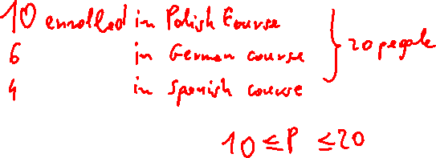
Inclusion-exclusion principle
The general formula for the cardinality/measure of the union of a finite
number of sets $A_{1},A_{2},…,A_{n}$:
$$\left|\bigcup_{i=1}^{n}{A_{i}}\right|=\sum_{i=1}^{n}{\left|A_{i}\right|}−\sum_{1≤i<j≤n}{\left|A_{i}+A_{j}\right|}+\sum_{1≤i<j<k≤n}{\left|A_{i}∩A_{j}∩A_{k}\right|}+…+{\left(−1\right)}^{n+1}\left|A_{1}∩…∩A_{n}\right|$$
In typical problems (school, university), the inclusion-exclusion principle
is used for two to four sets.
For a larger number of sets, computers are used.

